Slide 1
Springboard Foundations of Data Science Final Presentation
Eitan Boral

Slide 2
Analyzing Credit Card Default
Project Approach
Background and goal of study
Data set
Data wrangling
Preliminary exploration
Machine learning models
Conclusions
Recommendations

Slide 3
Analyzing Credit Card Default
Background
As of 2016
Revolving debt in the US reached $1 trillion in the US
Households with an unpaid credit card balance averaged $8,000, a 6% increase over 2015
Financial institutions issuing credit cards wrote off 3.32% of credit card loans
Goal
Our goal is to build a predictive model identifying characteristics of borrowers that can help financial institutions reduce their write-off rates
Exploration, cleaning and analysis of data is performed in the R programming language

Slide 4
Analyzing Credit Card Default
Data Set
Taiwanese Bank with 30,000 credit card loans in 2005
Dependent variable is binary event (default or no default in October of 2005)
23 independent variables including:
Credit limit amount, Age of borrower
Education level, Gender, Marriage status
Payment status over six separate months (April – September of 2005)
Balance status over six separate months (April – September of 2005)
Payment amount over six separate months (April – September of 2005)
Data from UCI Machine Learning Repository
http://archive.ics.uci.edu/ml/datasets/default+of+credit+card+clients#

Slide 5
Analyzing Credit Card Default
Data Wrangling
Import Data Set
Explore Structure
Delete Unnecessary Columns/Rows
Change Column Names
Transform data set to data frame
Transform columns to numeric type
Merge any duplicate values
Create new columns for further analysis

Slide 6
Analyzing Credit Card Default
Preliminary Exploration
Which variables appear to have predictive power of default?
Baseline default rate is 22.12%
Identify loans that default much more or less than baseline rate

Slide 7
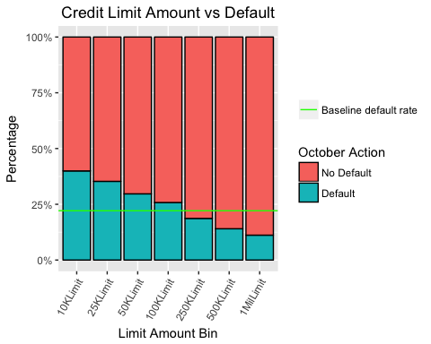
Analyzing Credit Card Default
Preliminary Exploration (Credit Limit)
Lower credit limits are associated with higher default rates, while higher default rates are associated with lower default rates

Slide 8
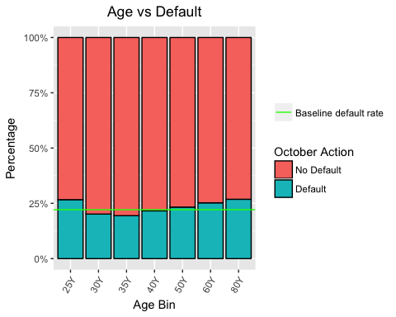
Analyzing Credit Card Default
Preliminary Exploration (Age)
Age at the extremes (very young or very old) have the highest default rates (27%). Middle aged borrowers (31-35) have the lowest default rates (19%).

Slide 9
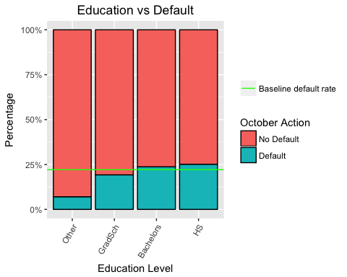
Analyzing Credit Card Default
Preliminary Exploration (Education)
A higher education level leads to a lower default rate.

Slide 10
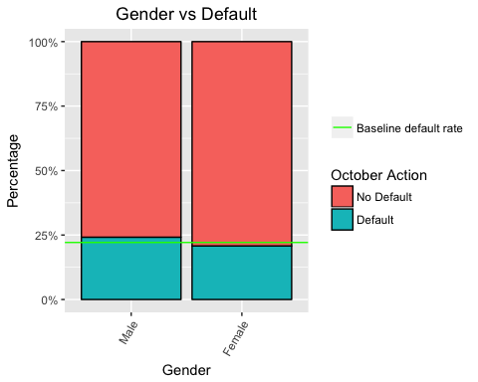
Analyzing Credit Card Default
Preliminary Exploration (Gender)
Men have a higher default rate than women.

Slide 11

Analyzing Credit Card Default
Preliminary Exploration (Marriage)
Divorced and married individuals both default above the baseline rate, while those that are single and have never been married default below the baseline

Slide 12
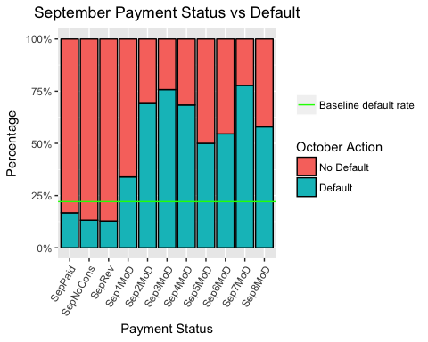
Analyzing Credit Card Default
Preliminary Exploration (Payment Status)
The earlier one pays off credit card debt, the less likely they are to default. Card holders one month or more behind are much more likely to default. Note that the default rate is 17% or less if one is not behind and jumps to 34% at one month behind.

Slide 13
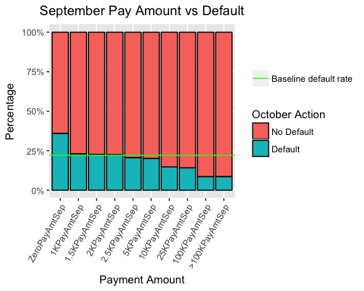
Analyzing Credit Card Default
Preliminary Exploration (Payment Amount)
The higher the payment amount each month, the lower the default rate. Those paying small amounts each month have high default rates.

Slide 14
Analyzing Credit Card Default
Machine Learning
With a baseline default rate of 22.12% (77.88% not defaulting), our goal is to build a model which can improve upon the baseline
Three machine learning models
Logistic Regression
Classification and Regression Tree (CART)
Random Forest

Slide 15
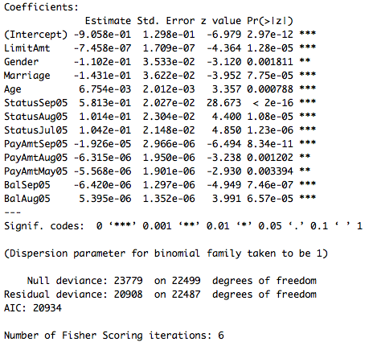
Analyzing Credit Card Default
Machine Learning (Logistic Regression)
Fourth iteration of model shows 12 variables are statistically significant with an AIC of 20934
Model accuracy of 81.2% which improves upon the baseline of 77.88%

Slide 16
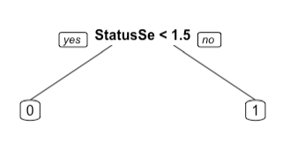
Analyzing Credit Card Default
Machine Learning (CART)
Model used all independent variables
Only one node which shows that the being one month behind or less in September is the greatest determinant of a loan defaulting.
Data set uses October as the dependent variable, which may explain why the preceding payment status month is the only node.
Model accuracy of 82.15%

Slide 17
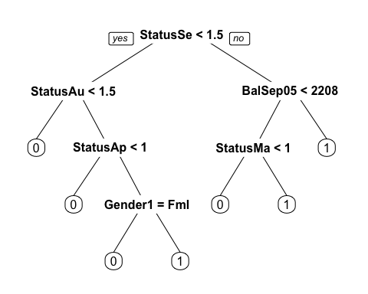
Analyzing Credit Card Default
Machine Learning (CART model 2)
Model used all independent variables
One node seems suspicious, so we change the control parameter to 0.0025.
This produces many more branches
Model accuracy of 82.08%

Slide 18
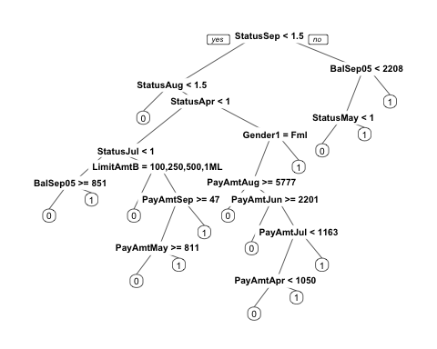
Analyzing Credit Card Default
Machine Learning (CART model 3)
Model used all independent variables
What about a control parameter of .0.001?
Even more branches than model 2
Model accuracy of 81.94%

Slide 19
Analyzing Credit Card Default
Machine Learning (Random Forest)
Selects data randomly with replacement
Model accuracy of 81.8%

Slide 20
Analyzing Credit Card Default
Conclusions
All three models improve upon the baseline for safe loans (77.88%)
Logistic regression model accuracy of 81.2%
CART model accuracy of 82.1%
Random forest model accuracy of 81.8%
Modest improvement of 3.5%-4.0% depending on the model
Most important variables appear to be monthly payment status

Slide 21
Analyzing Credit Card Default
Recommendations
Pair potential return of a loan with risk to assess the profitability of different types of loans. This is a more complete analysis than just predicting the probability of default. Interest assessed and collected for each loan will be needed to calculate profitability potential for each class of borrower.
Include credit rating and income in future studies for a more complete profile of the borrower.
Further examine the payment status variable to assess whether the conclusions of the CART model in this study are simply a function of September preceding the final month of the study.

